Slide 1
31 Api’s of Intelligence
Microsoft Cognitive Services

Slide 2

Bringing it all together
The Seeing AI App
Computer Vision, Image, Speech Recognition, NLP, and ML from Microsoft Cognitive Services
Read Blog Here
Watch Video Here
Notes:
Here’s a preview of the Seeing AI app, which started as a research project that helps people who are visually impaired or blind to understand who and what is around them.
The app will use computer vision, image & speech recognition, natural language processing and machine learning from Microsoft Cognitive Services. The app is under development and is not available today but it shows what’s possible with the APIs.

Slide 3

DEMO
Cognitive Bots
Notes:
Xiaomin

Slide 4
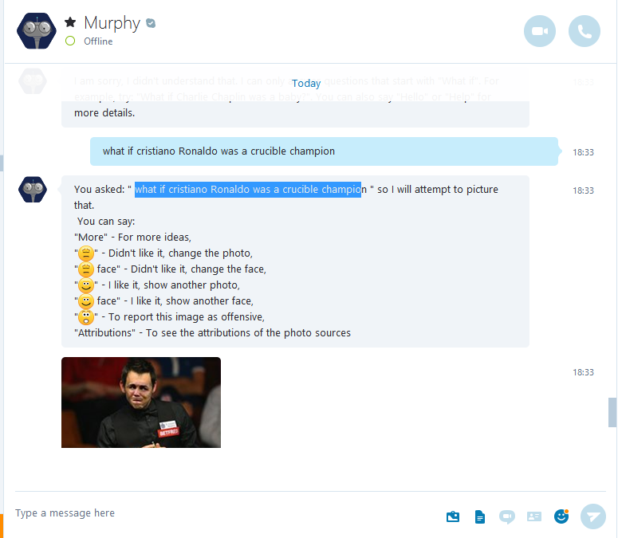
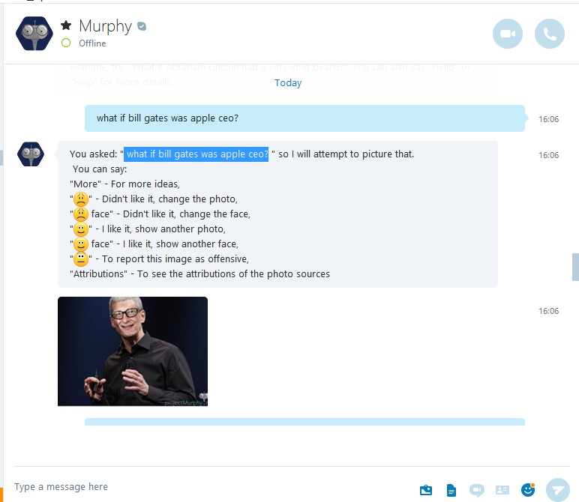

Slide 5
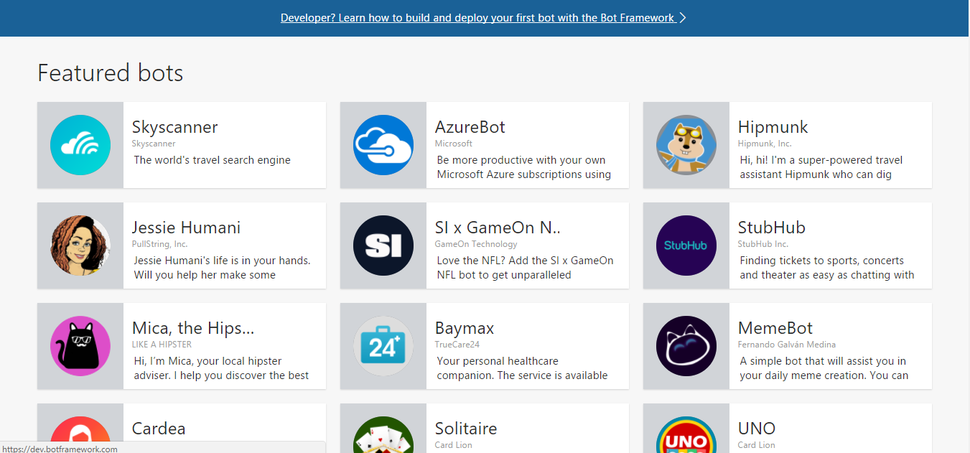

Slide 6
DEMO
Computer Vision, Face & Emotion APIs
Notes:
Xiaomin

Slide 7
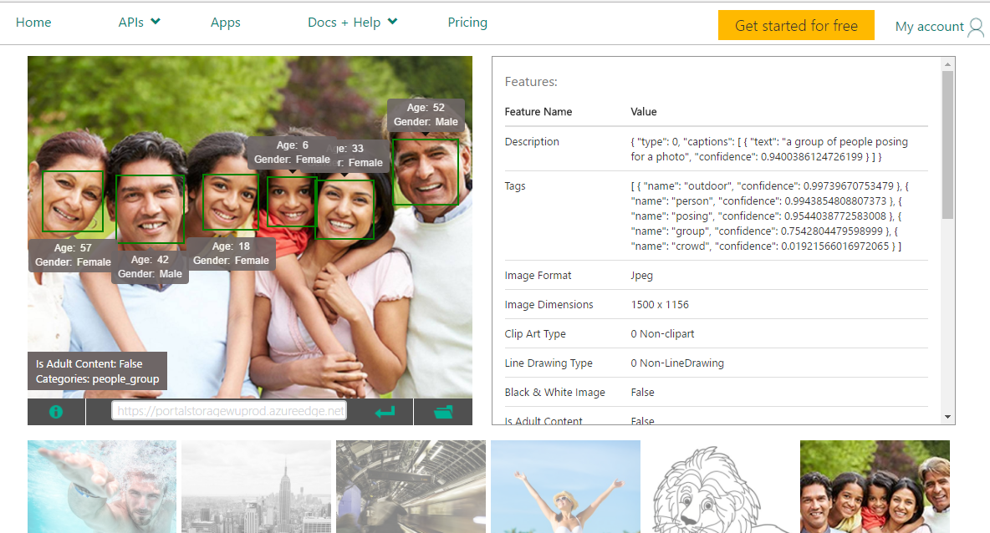

Slide 8
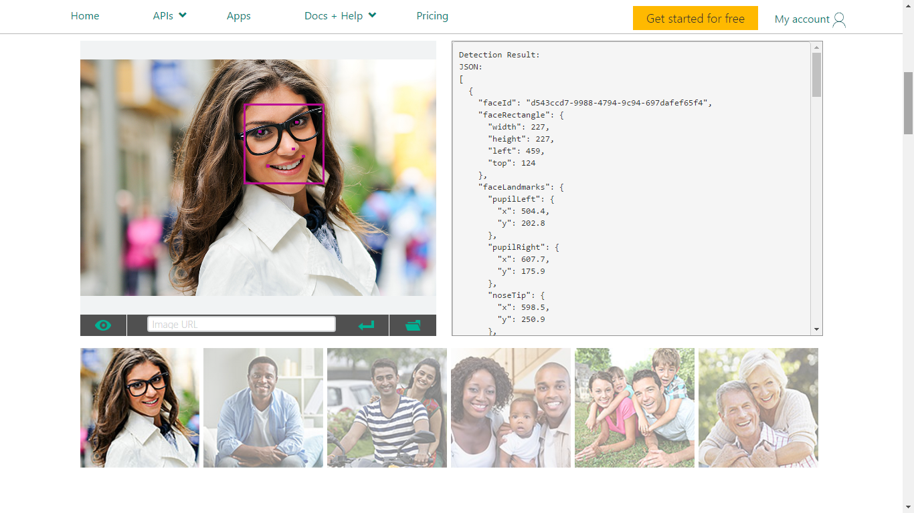

Slide 9
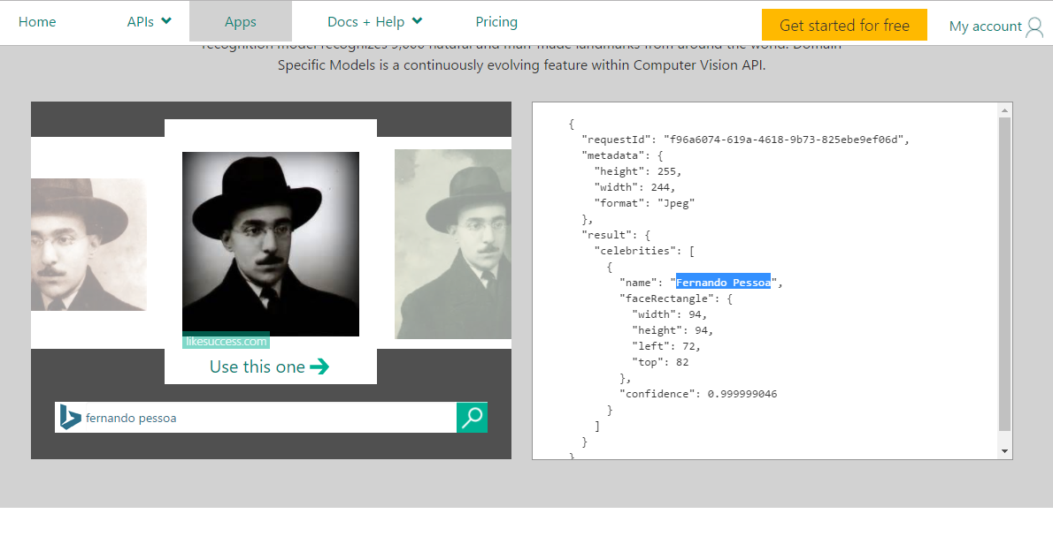

Slide 10







Why Microsoft Cognitive Services ?
Easy
Flexible
Tested
Roll your own with REST APIs
Simple to add: just a few lines of code required
Integrate into the language and platform of your choice
Text, Image, Video, Speech
Breadth of offerings helps you find the right API for your app
Built by experts in their field from Microsoft Research, Bing, and Azure Machine Learning
Quality documentation, sample code, and community support
GET A KEY
BUILD
Notes:
Why choose these APIs? They work, and it’s easy.
Easy: The APIs are easy to implement because of the simple REST calls. Being REST APIs, there’s a common way to implement and you can get started with all of them for free simply by going to one place, one website, www.microsoft.com/cognitive. (You don’t have to hunt around to different places.)
Flexible: We’ve got a breadth of intelligence and knowledge APIs so developers will be able to find what intelligence feature they need; and importantly, they all work on whatever language, framework, or platform developers choose. So, devs can integrated into their apps—iOS, Android, Windows—using their own tools they know and love (such as python or node.js, etc.).
Tested: Tap into an ever-growing collection of powerful AI algorithms developed by experts. Developers can trust the quality and expertise build into each API by experts in their field from Microsoft’s Research organization, Bing, and Azure machine learning and these capabilities are used across many Microsoft first party products such as Cortana, Bing and Skype.

Slide 11






Cognitive Services in Details
#MicrosoftCognitive
Cognitive Services
Vision
Speech
Language
Knowledge
Search
Computer Vision
Customer Recognition
Bing Speller
Academic Knowledge
Bing
Web Search
Emotion
Speaker Recognition
Linguistic Analysis
Entity Linking
Bing
Image Search
Speech
Language Understanding
Knowledge Exploration
Bing
Video Search
Face
Text Analytics
Recommendations
Bing
News Search
Video
Web Language Model
QnA Maker
Bing
Autosuggest
Moderator
Translator
Notes:
Todo: Change to generic icons (no inner logo)

Slide 12
Code sample - vision
using Microsoft.ProjectOxford.Vision;
using Microsoft.ProjectOxford.Vision.Contract;
// Create Cognitive Services Vision API Service client
VisionServiceClient VisionServiceClient = new VisionServiceClient(SubscriptionKey);
// Analyze the url for all visual features
VisualFeature[] visualFeatures = new VisualFeature[] {
VisualFeature.Adult,
VisualFeature.Categories,
VisualFeature.Color,
VisualFeature.Description,
VisualFeature.Faces,
VisualFeature.ImageType,
VisualFeature.Tags };
AnalysisResult analysisResult = await VisionServiceClient.AnalyzeImageAsync(imageUrl, visualFeatures);
return analysisResult;
Notes:
Xiaomin

Slide 13
Code sample – face detect
public ObservableCollection<Face> DetectedFaces = new ObservableCollection<Face>();
var faceServiceClient = new FaceServiceClient(subscriptionKey);
Contract.Face[] faces = await faceServiceClient.DetectAsync(fileStream, false, true,
new FaceAttributeType[] { FaceAttributeType.Gender,
FaceAttributeType.Age,
FaceAttributeType.Smile,
FaceAttributeType.Glasses });
foreach (var face in faces) {
DetectedFaces.Add(new Face() {
ImagePath = SelectedFile,
Left = face.FaceRectangle.Left,
Top = face.FaceRectangle.Top,
Width = face.FaceRectangle.Width,
Height = face.FaceRectangle.Height,
FaceId = face.FaceId.ToString(),
Gender = face.FaceAttributes.Gender,
Age = string.Format("{0:#} years old", face.FaceAttributes.Age),
IsSmiling = face.FaceAttributes.Smile > 0.0 ? "Smile" : "Not Smile",
Glasses = face.FaceAttributes.Glasses.ToString(),
});
}
Notes:
Xiaomin

Slide 14
Code sample – emotions
using Microsoft.ProjectOxford.Emotion;
using Microsoft.ProjectOxford.Emotion.Contract;
// Create Project Oxford Emotion API Service client
EmotionServiceClient emotionServiceClient = new EmotionServiceClient(subscriptionKey);
try {
// Detect the emotions in the URL
Emotion[] emotionResult = await emotionServiceClient.RecognizeAsync(url);
return emotionResult;
}
catch (Exception exception) {
return null;
}
Notes:
Xiaomin

Slide 15


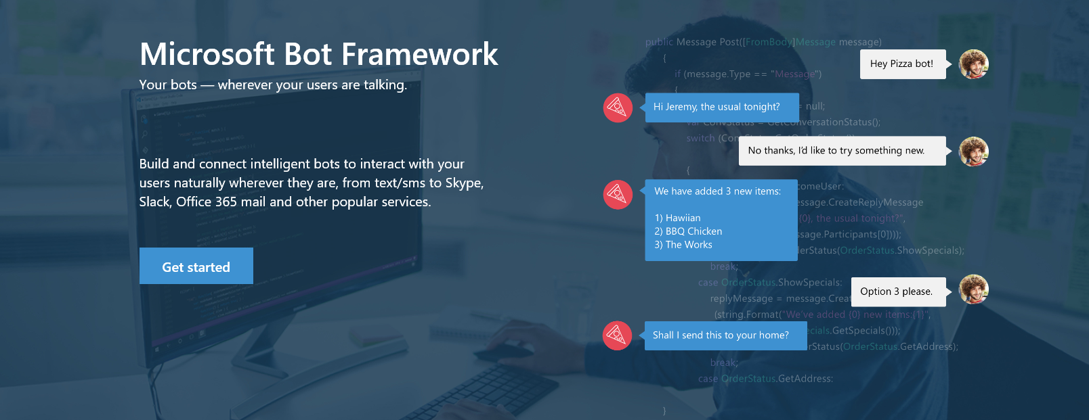
Bot Framework
www.botframework.com

Slide 16

Bot Framework Preview Your bots – wherever your users converse
Bot Connector Service
Connect your bot(s) seamlessly to text/sms, Office 365 mail, Skype, Slack, Twitter and more
A service to register your bot, configure channels and publish to the Bot Directory
Bot Builder SDK
Everything you need to build great dialogs within your Node.js or C# bot
An open source SDK hosted on GitHub
Bot Directory
Discover, try, and add bots to conversation experiences
A public directory of bots registered and approved with Bot Framework

Slide 17
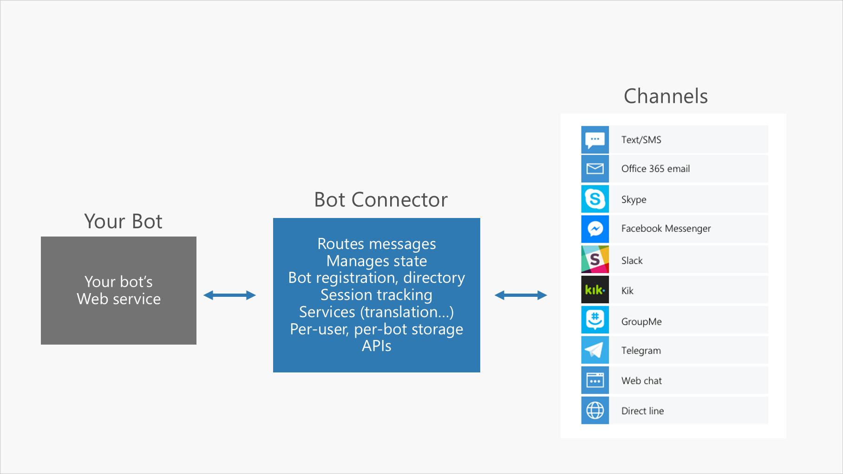

Slide 18
DEMO
Bot Framework
Notes:
Xiaomin

Slide 19
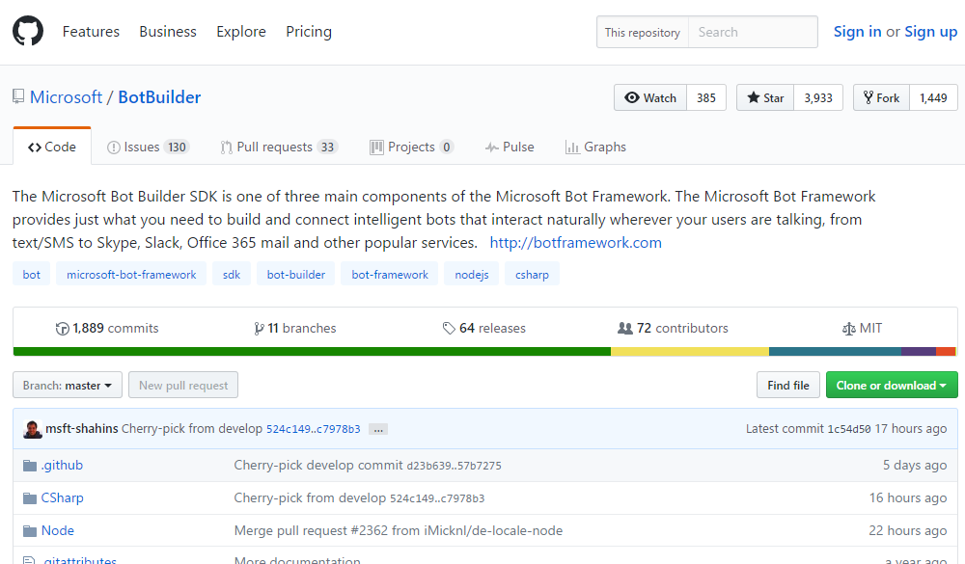

Slide 20
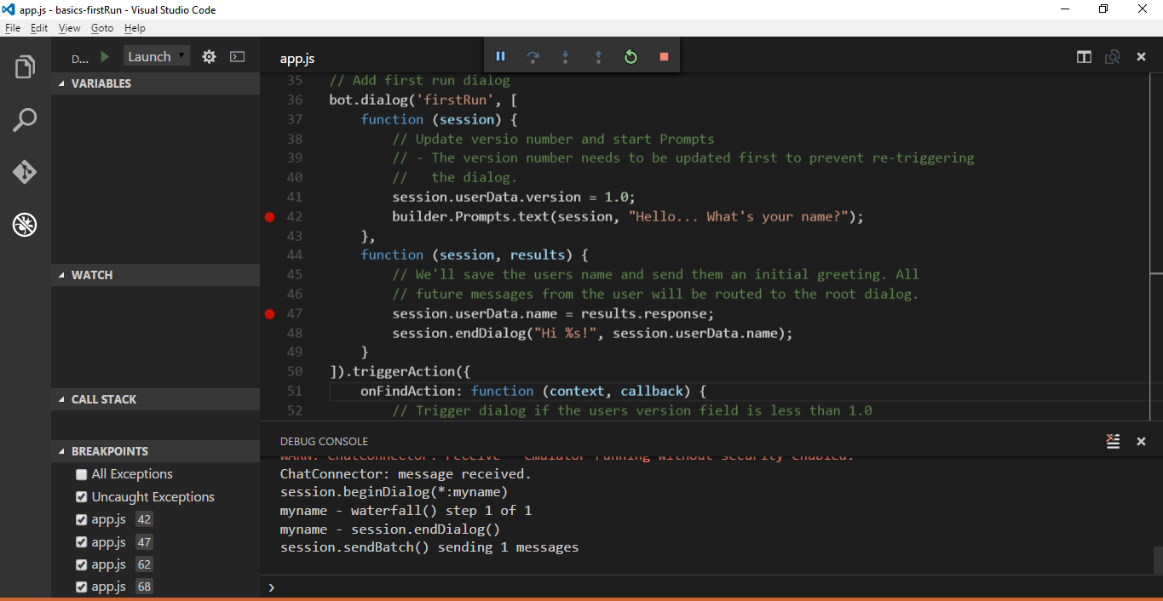
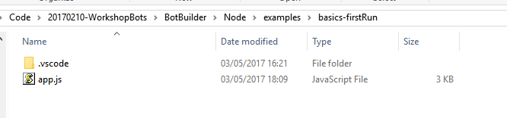

Slide 21
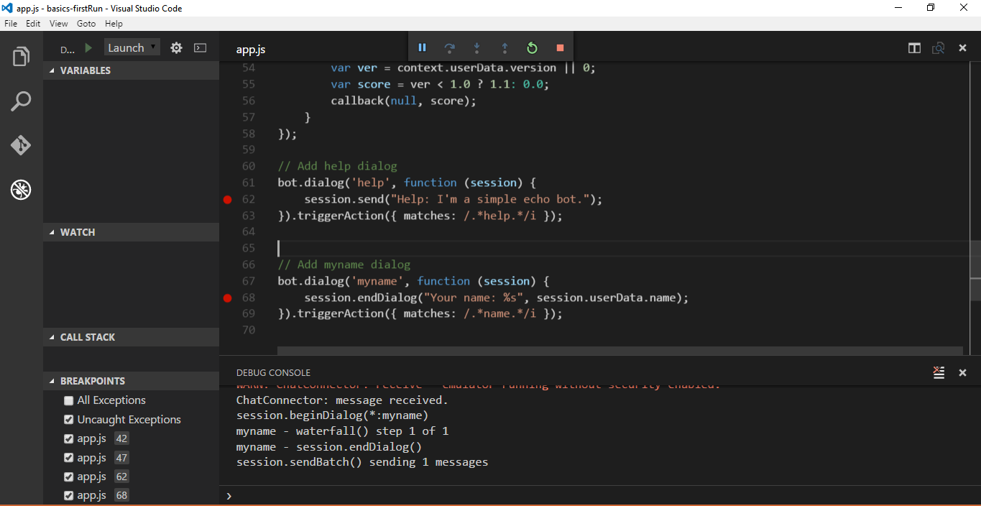

Slide 22
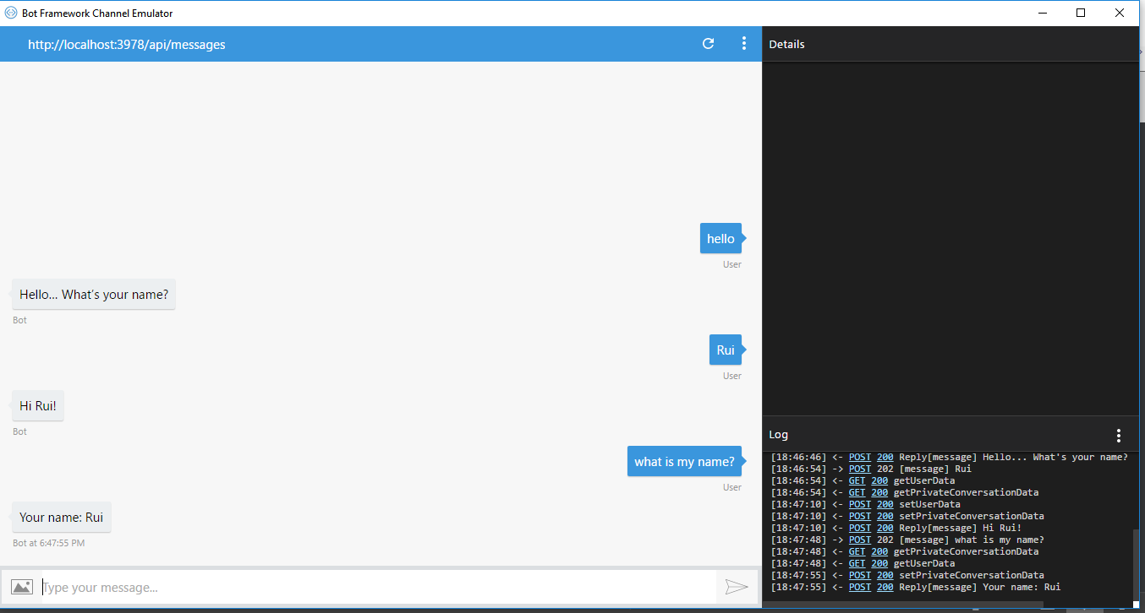

Slide 23
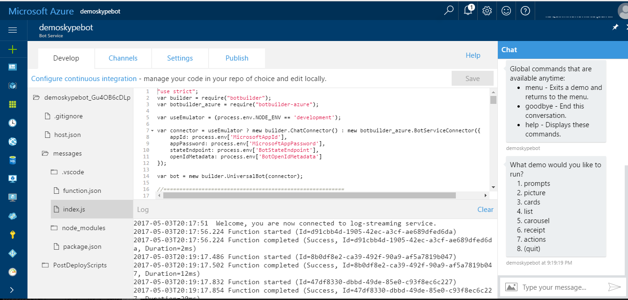

Slide 24
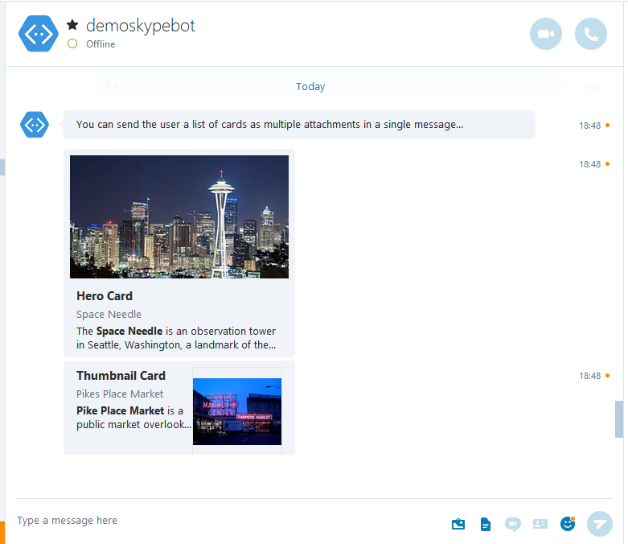
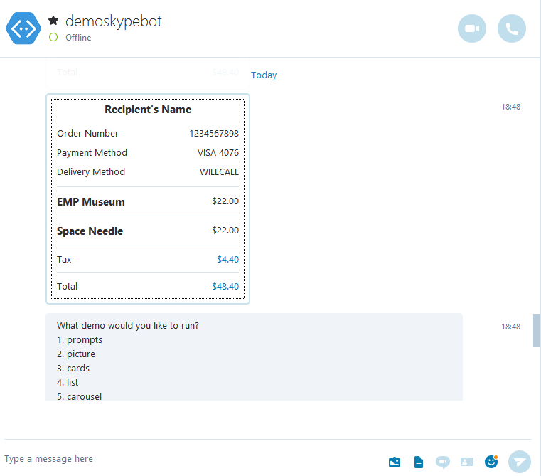

Slide 25


LUIS
Understand what your users are saying
Use pre-built Bing & Cortana models or create your own
Notes:
Xiaomin

Slide 26
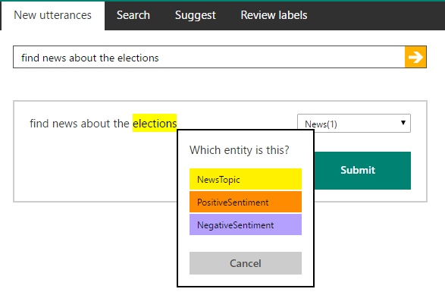
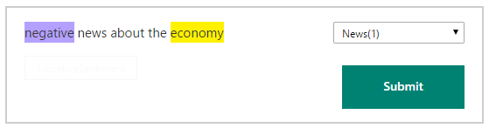
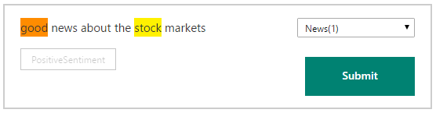
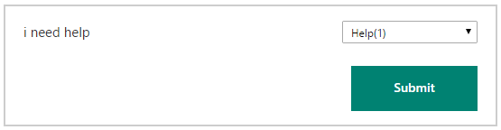

Slide 27
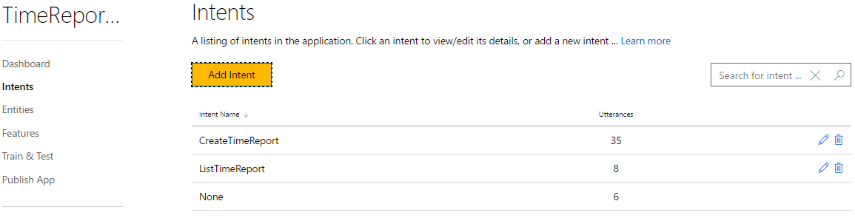
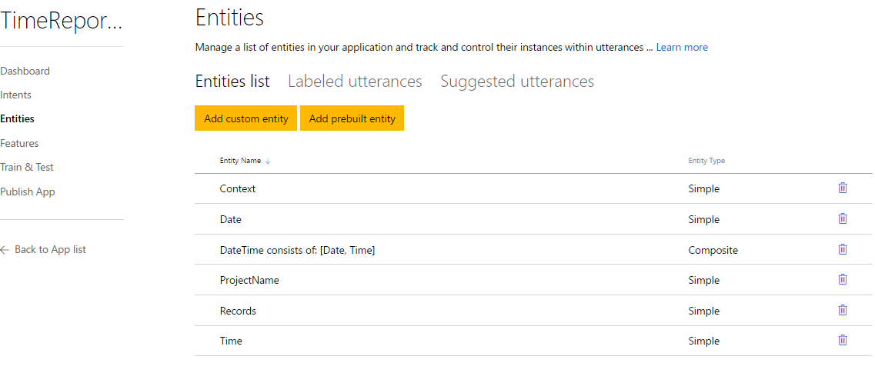

Slide 28
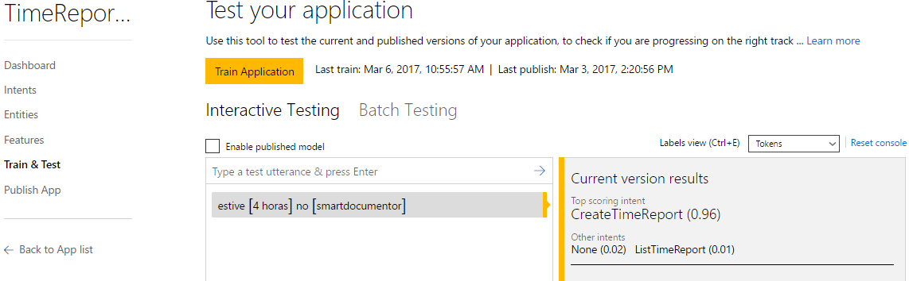

Slide 29
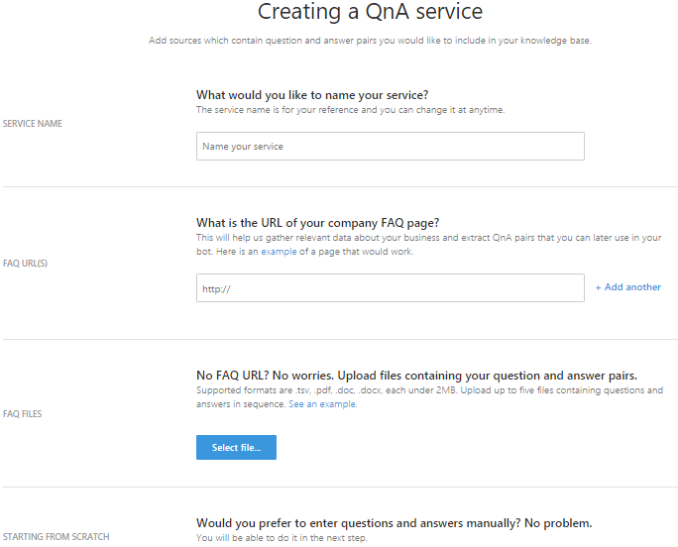
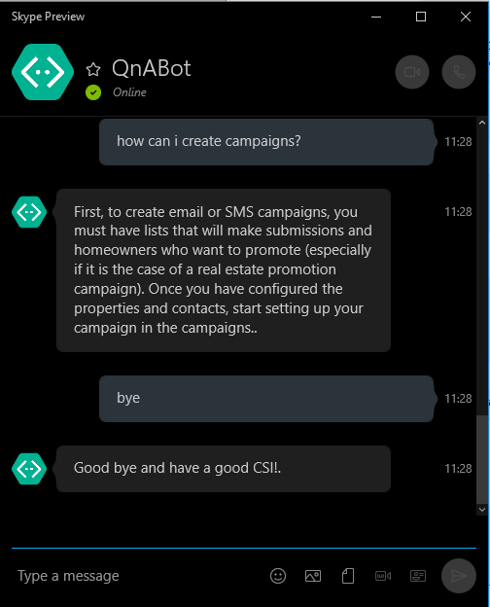

Slide 30
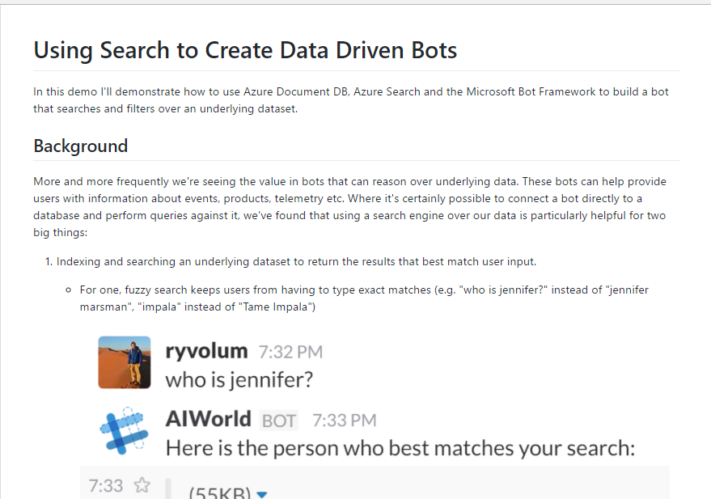
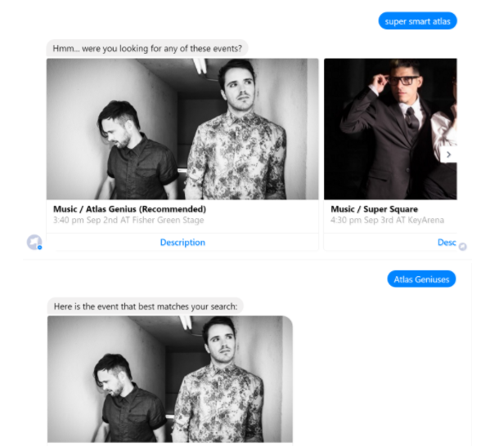

Slide 31

Cortana Intelligence Suite Transform data into intelligent action
Information Management
Big Data Stores
Machine Learning and Analytics
Intelligence
Data Sources
People
Data Factory
Data Lake Store Blob Store
Machine Learning
Cognitive Services
Data Catalog
SQL Data
Warehouse
Data Lake Analytics
Bot Framework
Web
Apps
HDInsight
(Hadoop and Spark)
Event Hub
Cortana
Mobile
Apps
Stream Analytics
Bots
Dashboards & Visualizations
Sensors and devices
Power BI
Automated Systems
Data
Intelligence
Action

Slide 32
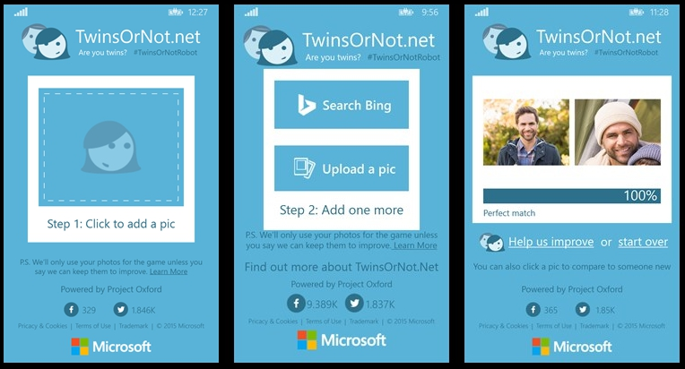
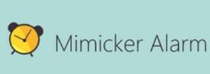
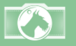
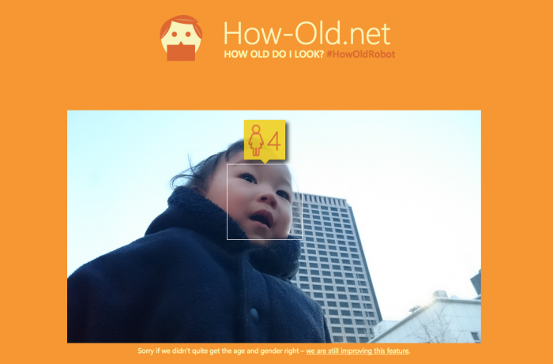

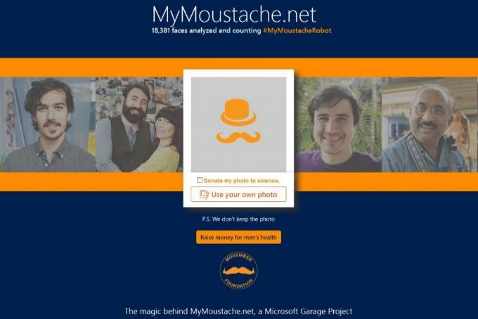
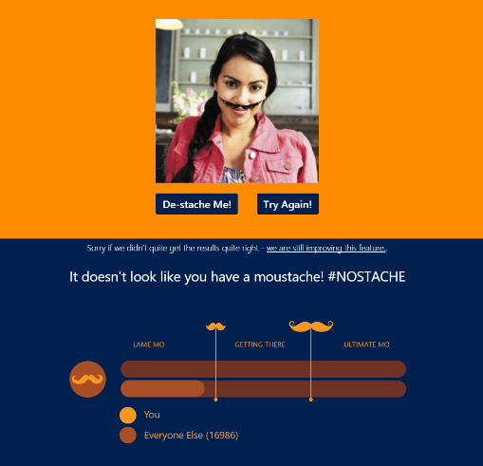
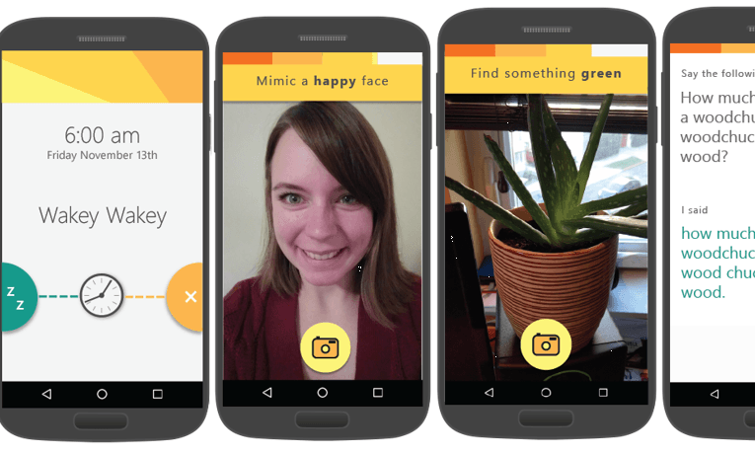
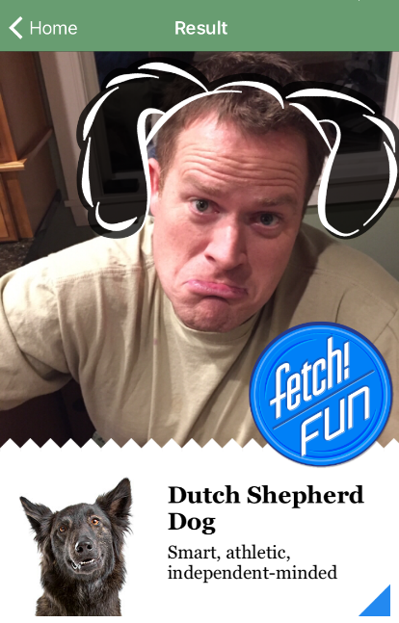
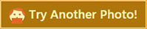
Our showcase apps
Fetch

Slide 33
Custom Models
(Machine Learning/ Deep Learning )
Notes:
Xiaomin

Slide 34
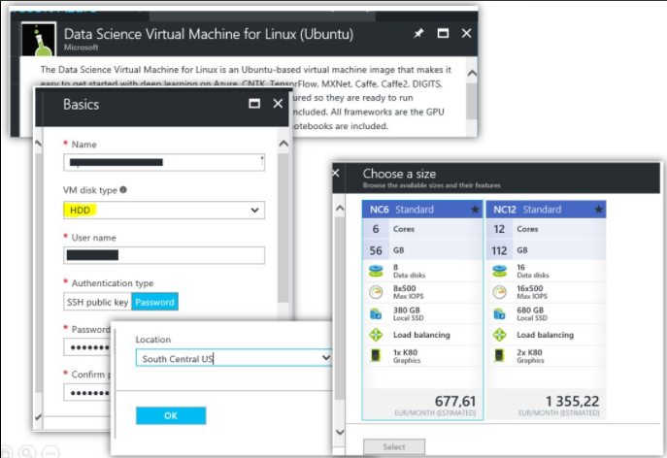

Slide 35
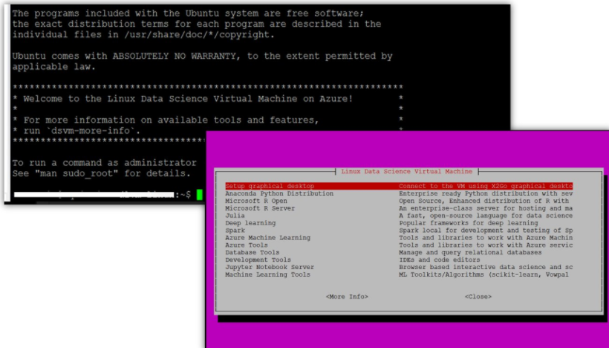

Slide 36
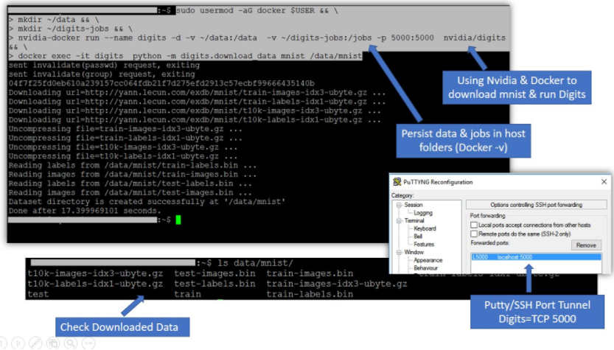
https://gist.github.com/rquintino/988880ad8705033519431d532ce6336c

Slide 37
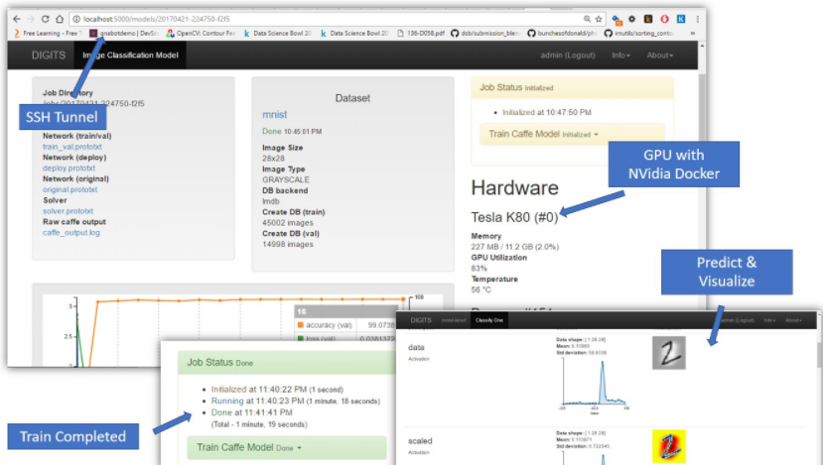

Slide 38
Resources
Get an Azure Subscription
http://azure.microsoft.com
Check the Cognitive Services Documentation
https://www.microsoft.com/cognitive-services/en-us/documentation
Access samples and the APIs
https://www.microsoft.com/cognitive-services
Client SDK
https://github.com/Microsoft/ProjectOxford-clientsdk
The Bot Framework
http://botframework.com/
Bot Builder
https://github.com/Microsoft/BotBuilder

Slide 39

Q/A

